Slide 1
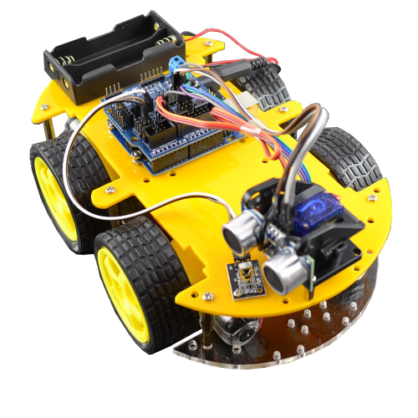
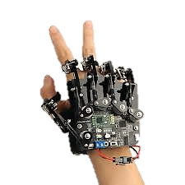
Controlling Car With Hand Motion

Slide 2
Project maker Name (E28)
Abdelrahman Alaa Fouad

Slide 3
introduction
This project aims to control a car direction and speed using hand motion :
Hand Module must fast responsively detect the posture of fingers.
BT module after receiving the fingers’ posture, L293D must activate the motor direction.
According to the finger posture, the car will move, and we can control the speed of motors
by using Thumb posture.
LCD displays the current direction that car immediately move

Slide 4
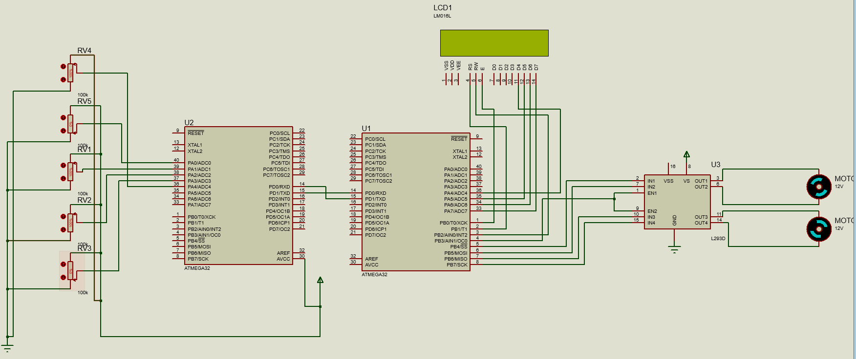
Car And Hand Modules In Proteus

Slide 5
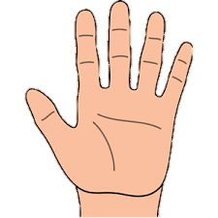








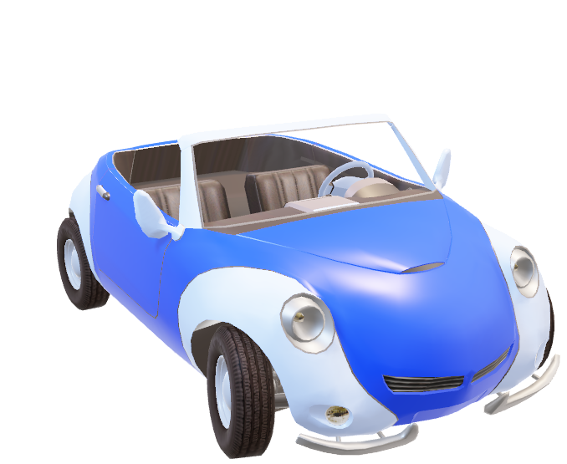





Normal Speed

Slide 6







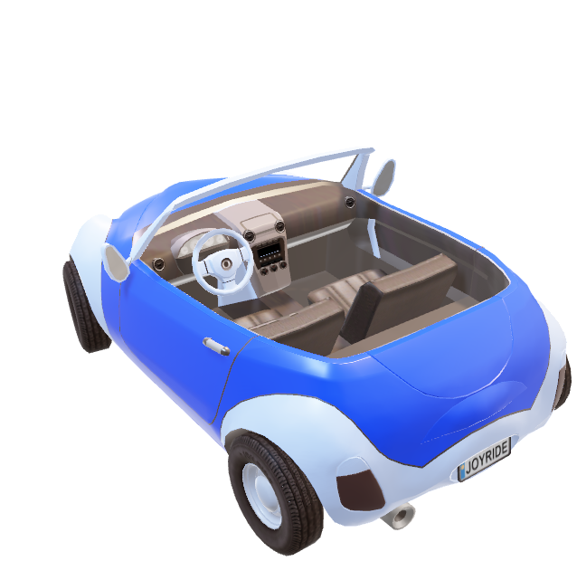



Normal Speed

Slide 7
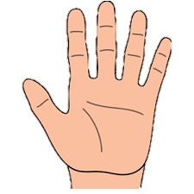


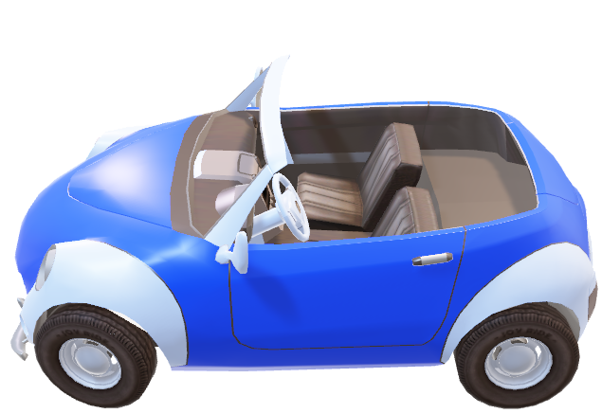

Normal Speed

Slide 8





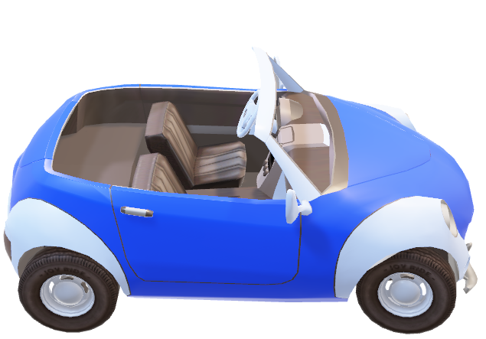


Normal Speed

Slide 9




Double Speed

Slide 10




Double Speed

Slide 11




Double Speed

Slide 12



Double Speed

Slide 13
finally
We hope to develop our project to be easier and more comfortable soon

